Slide 1
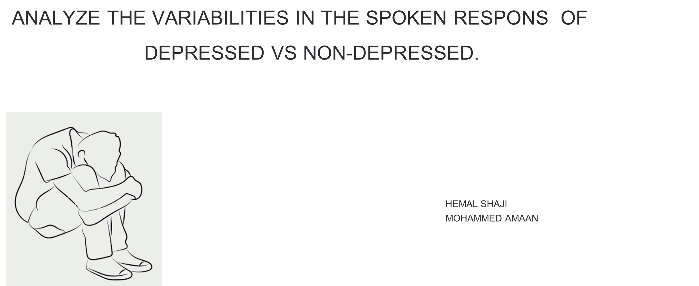

Slide 2
DATA COLLECTION
•People in the age group of 18 - 35
•Fluent in Indian English and Malayalam,
• participants were classified into five depression severity categories based on their PHQ-9 score
• None: 39 participants
• Mild: 63 participants
• Moderate: 36 participants
• Moderately Severe: 7 participants
• Severe: 4 participants
•They have selected 15 words (three from each of the five ANEW categories)
-They has stored the transcript of each audio responses.

Slide 3
TASK FOR PARTCIPANTS
1) Affective Rating Task
Participants viewed each word and rated their valence and arousal 9 point Likert scale
The SAM scale served as a visual aid for self reported valence and arousal ratings
2)Property Generation Task
Participants verbally de scribed their thoughts, feelings, and memories evoked by each word
for a minimum of 20 seconds. They were presented with 15 such words. They were instructed
to avoid single words, phrases, or definitions, Before the experiment, participants received an
example word and spoken response to familiarize them with the task
3)Mental Health Survey
Participants completed the Patient Health Questionnaire (PHQ-9). Participants read each
statement and selected the response that best described their current state of mind. The
PHQ-9 score was obtained by summing the ratings of its 9 items (0-3 scale).

Slide 4
DEPRESSION DETECTION FROM TEXT
Hypothesis: Non-depressed individuals use more positive words in their text responses, while depressed individuals tend to use more negative words. Therefore, analyzing sentiment scores and word counts can help distinguish between these two groups.
Objectives:
-Determine positive and negative sentiment scores for each text response.
-Count the occurrences of positive and negative emotion words in each response.
-Compare sentiment scores and word counts between non-depressed and
depressed individuals.
To assess emotional variability in text from audio, categorize words into HVHA and LVLA groups and analyze their frequency and context. Depressed individuals often show less variability in emotional expressions, with frequent low-arousal words suggesting reduced emotional range and possible depression

Slide 5
VEDAR
VADER (Valence Aware Dictionary and Sentiment Reasoner) is used for analyzing sentiment in text, determining how positive, negative, or neutral the text is.
VADER provides sentiment scores from -1 (most negative) to +1 (most positive), allowing you to gauge the emotional tone of the text.

Slide 6
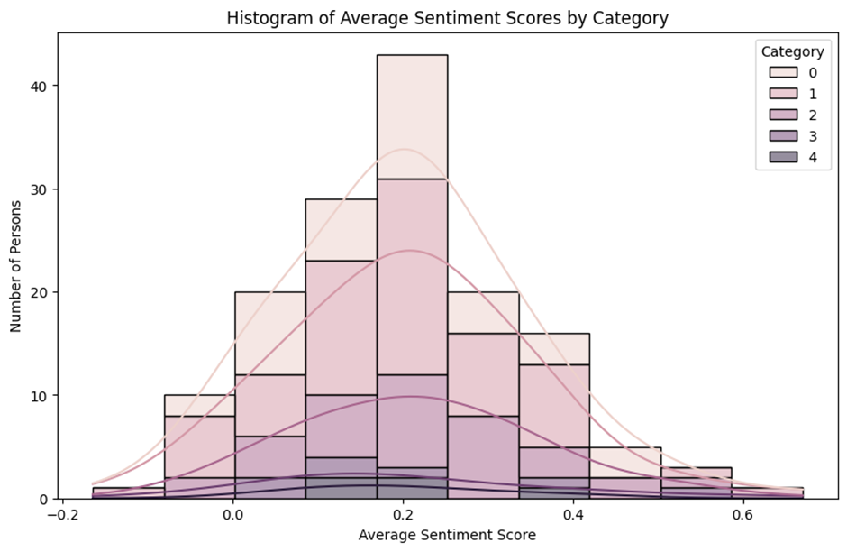
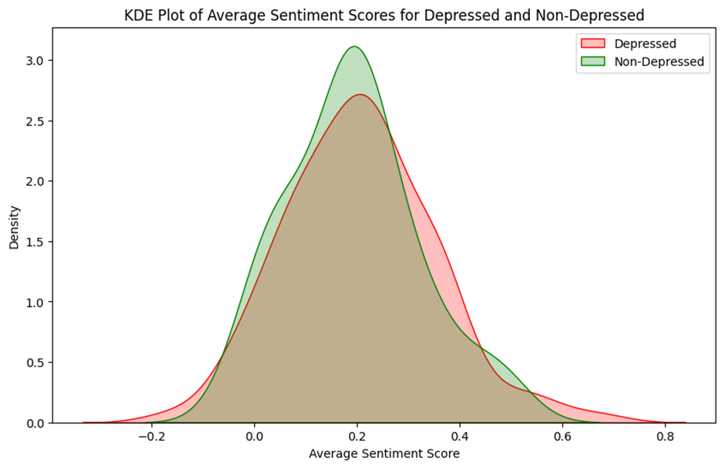
AVG SENTIMENT SCORE-5 CATEGORY
KDE FOR AVERAGED DEPREESED AND NON DEPPRESSED
They have already conducted phq 9 test between the every participant.
5 Categories based on phq 9
We have taken the average that is by
sum of 15 sentence scores of each person/15
Averaged sentiment score
Classified into 2 categories depressed and non depressed

Slide 7
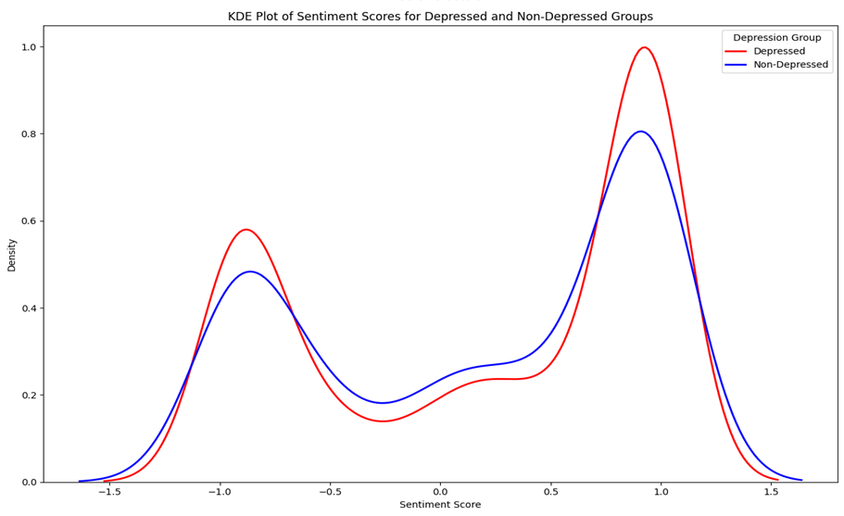
KDE FOR DEPRESSED AND NON-DEPRESSED GROUP FOR EVERY SENTENCE SENTIMENT SCORE
Both groups have two main peaks, suggesting two common sentiment ranges for each group.
The depressed group (red) has a higher peak around 1.0, indicating more instances of moderately positive sentiment compared to the non-depressed group.
The non-depressed group (blue) has a slightly higher and wider distribution in the middle range (around 0), suggesting more neutral or mixed sentiments.
Both groups have a smaller peak around -1.0, representing negative sentiments, but this peak is slightly higher for the depressed group.

Slide 8
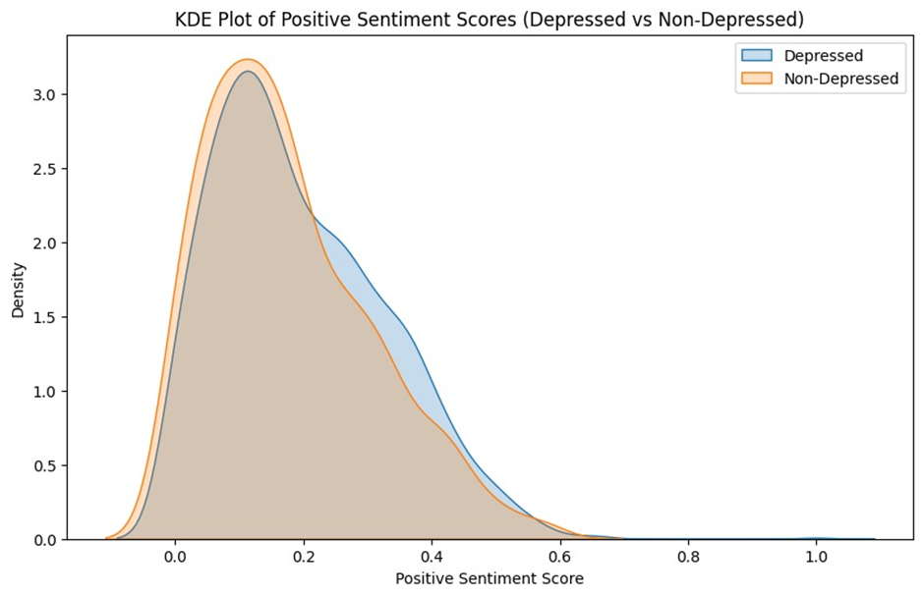
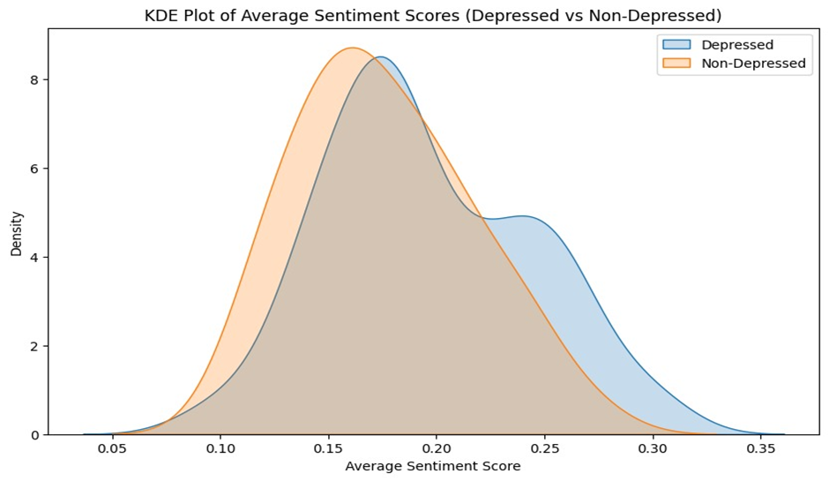
POSITIVE SENTIMENT SCORE
1st graph shows the positive sentiment score for each sentences
2nd graph shows the averaged positive score that is by taking the sum of 15 score of each person and divide it by 15
in this both graph we are unable to distinguish depressed and non-depressed based on positive score

Slide 9
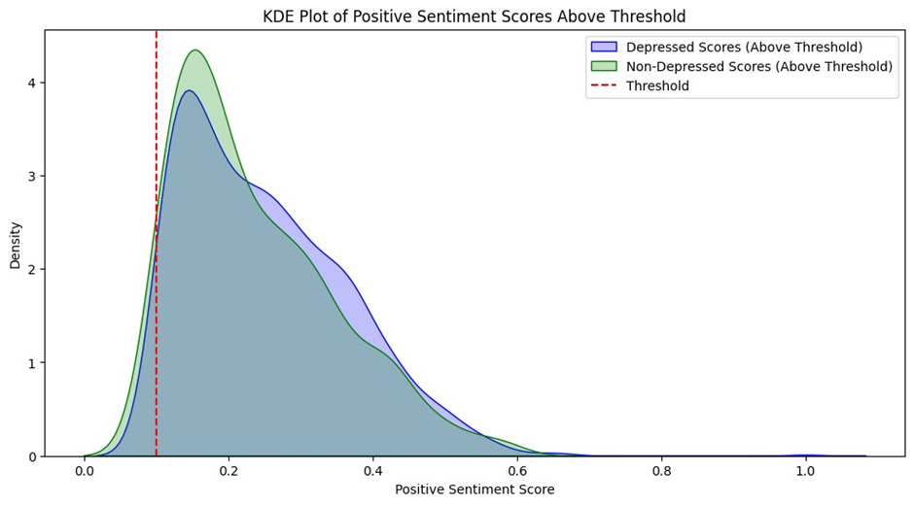
THRESHOLD OF 0.1 FOR POSITIVE SENTIMENT SCORE FOR ALL SENTENCE
This graph shows the distribution of positive sentiment scores above a certain threshold 0.1.
The non-depressed group (green) has a higher and narrower peak just after the threshold.
The depressed group (blue), while having a lower peak, still shows a wider distribution extending into higher positive scores.They can still experience a range of positive emotions, sometimes even of higher intensity than the non-depressed group.

Slide 10
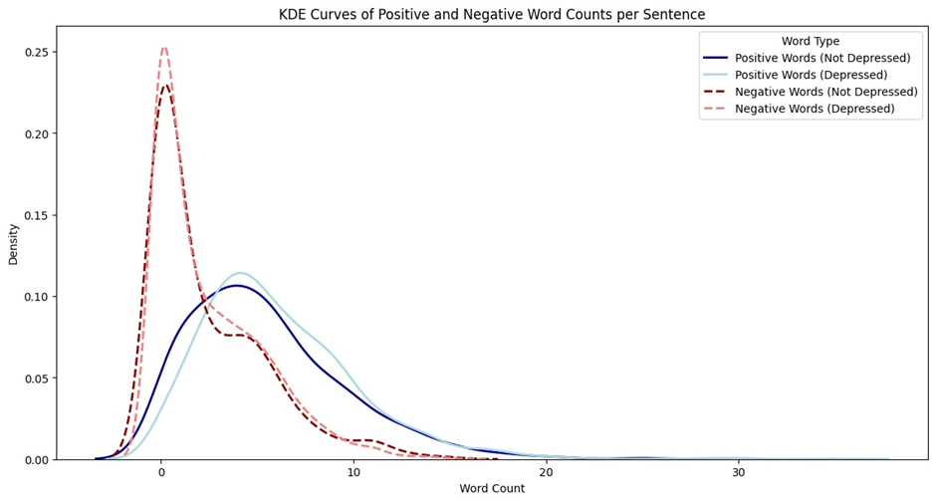
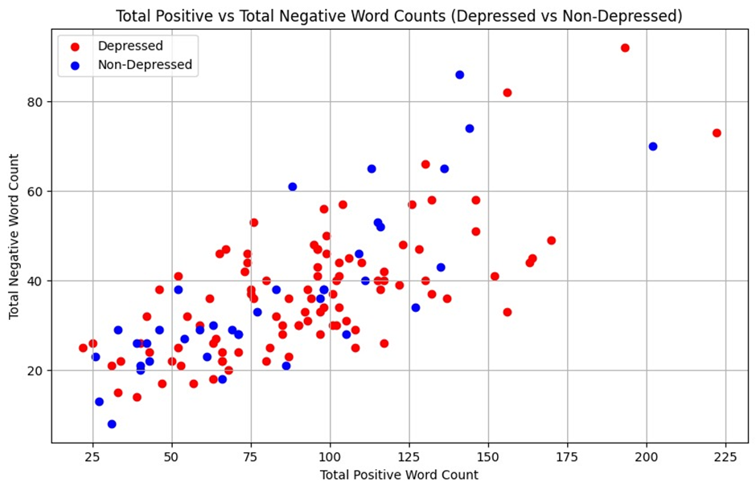
POSITIVE AND NEGATIVE WORD COUNT
1st graph show positive and negative word count per sentences
2nd graph show the total positive and negative word count per person that is taking the sum of count of 15 sentences of each persons
here also both peaks are overlapping at same point so we are unable to distinguish between depressed and non- depressed by looking the graph

Slide 11
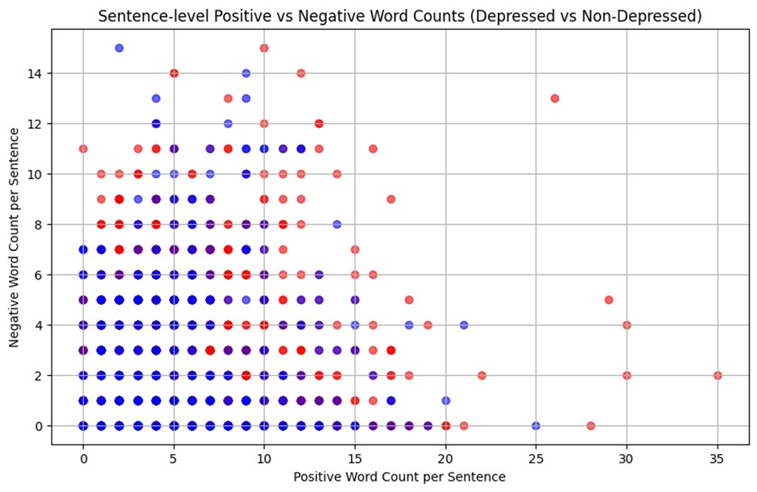
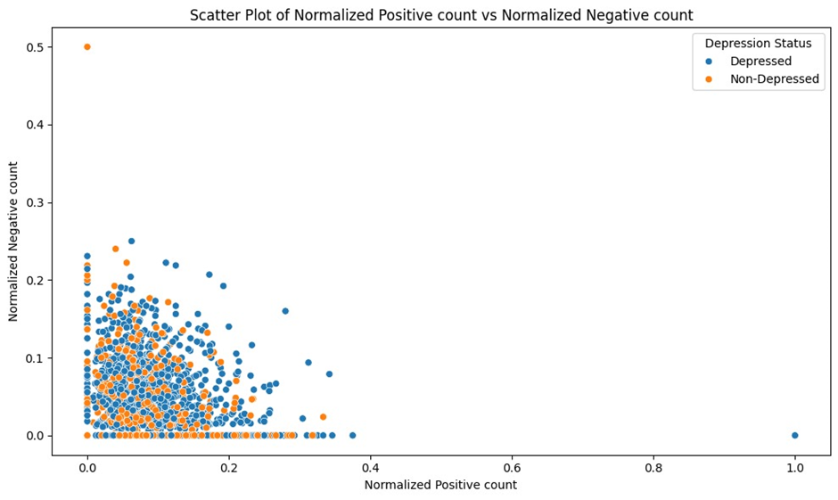
POSTIVE VS NEGATIVE COUNT PER SENTENCE
1st graph show the positive vs negative count of each sentences using Scatter plot
2nd graph show the normalized form of positive and negative count using scatter plot
both graphs overlap significantly,we cannot find any relation for depressed and non-depressed groups.

Slide 12
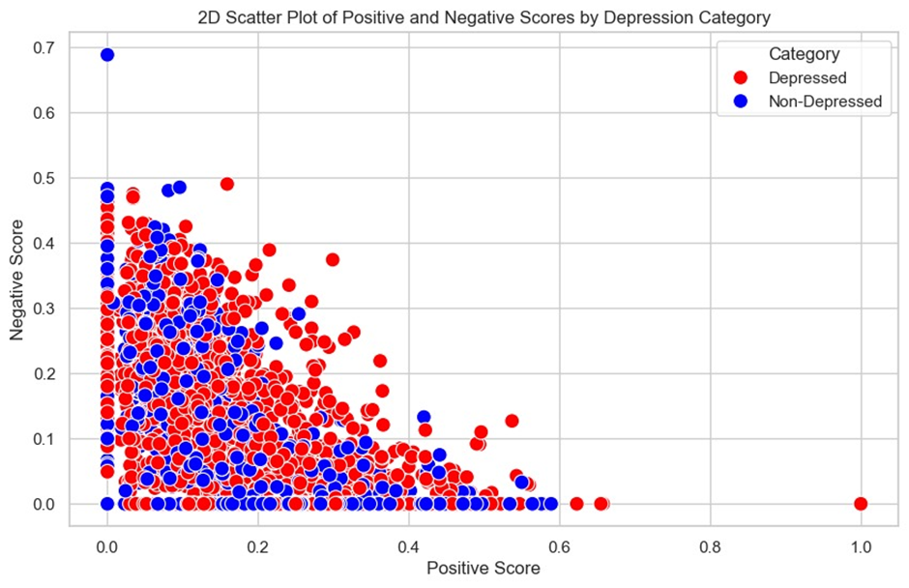
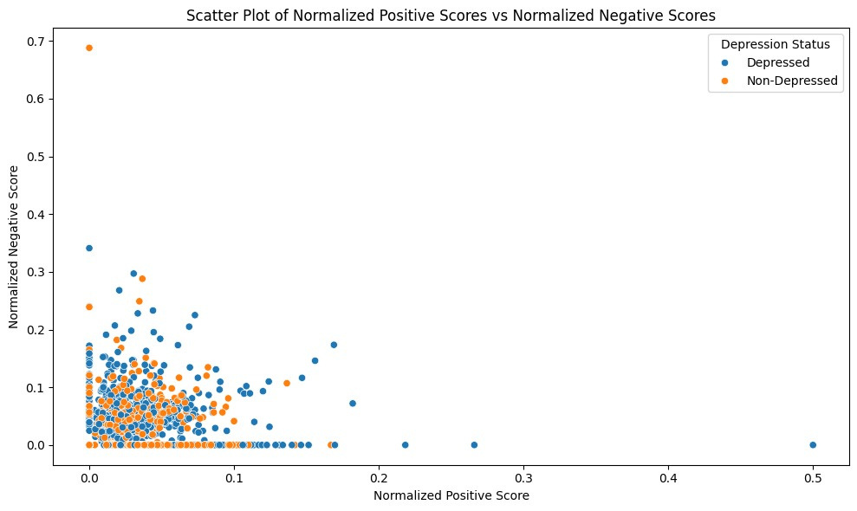
POSITIVE VS NEGATIVE SCORE
1st graph show the positive vs negative score of each sentences
2nd graph show the normalized form of positive and negative score
normalized score = score/positive word count + negative word court
There's significant overlap between the two groups, indicating that depression can't be perfectly determined by these scores alone.

Slide 13
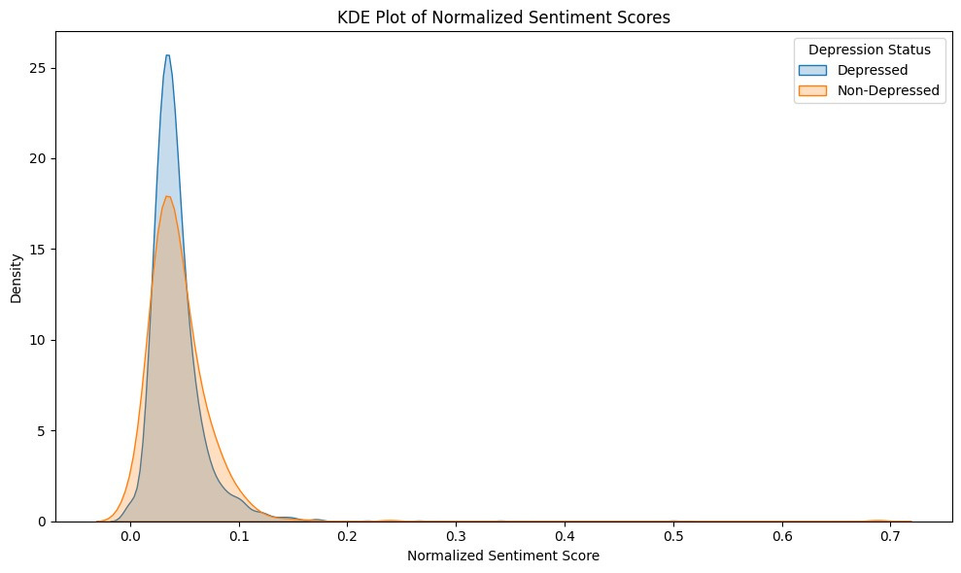
NORMALIZED SENTIMENTAL SCORE PER SENTENCE
Both depressed and non-depressed groups have similar overall distributions of sentiment scores.
The peak for depressed individuals (blue) is slightly higher and narrower, indicating more concentrated sentiment scores.
Non-depressed individuals (orange) show a slightly wider distribution, suggesting more variability in sentiment.

Slide 14
TEXTBLOB
TextBlob is a simple and easy-to-use library for processing text data, including sentiment analysis.
Polarity Score: Ranges from -1 to 1. A score of -1 indicates the most negative sentiment, 0 indicates neutral, and +1 indicates the most positive sentiment.

Slide 15
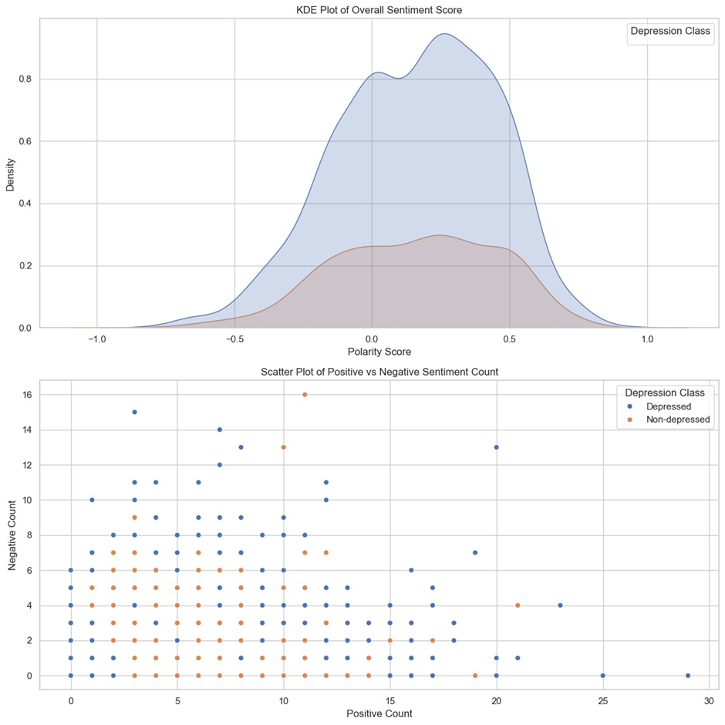
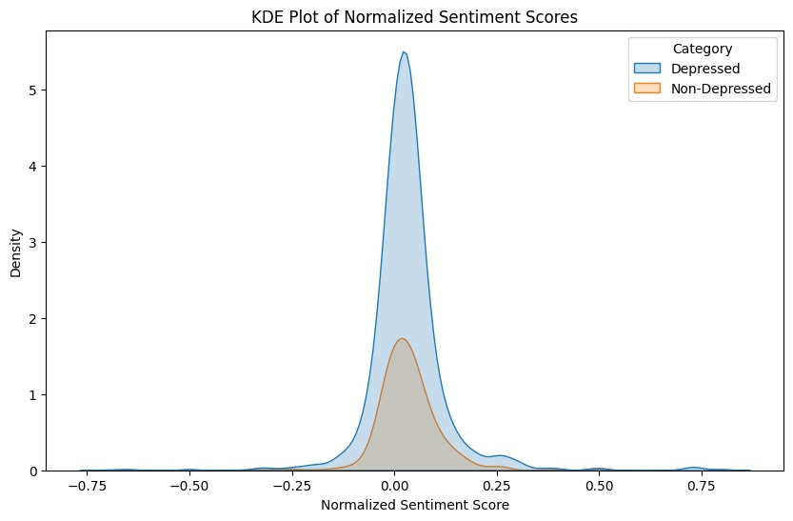
SENTIMENT SCORE PER SENTENCE
1st graph show sentiment score per each sentences
2nd graph show the normalized score

Slide 16
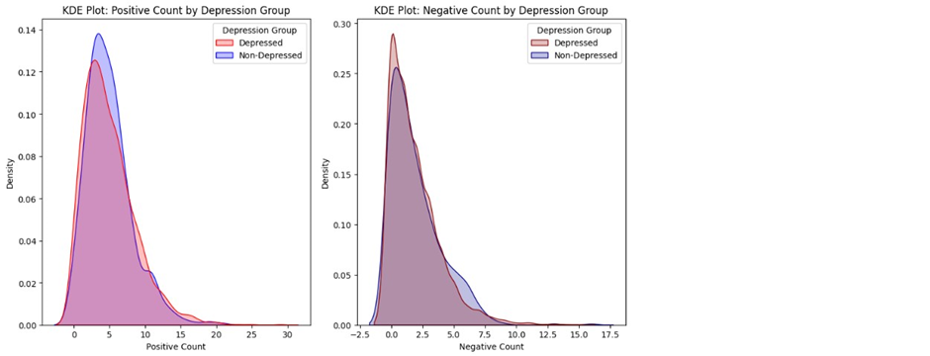
POSITIVE VS NEGATIVE COUNT PER SENTENCE
1st graph show the positive vs negative count of each sentences using Scatter plot
2nd graph show the normalized form of positive and negative count using Kde plot
both graphs overlap significantly,we cannot find any relation for depressed and non-depressed groups.

Slide 17
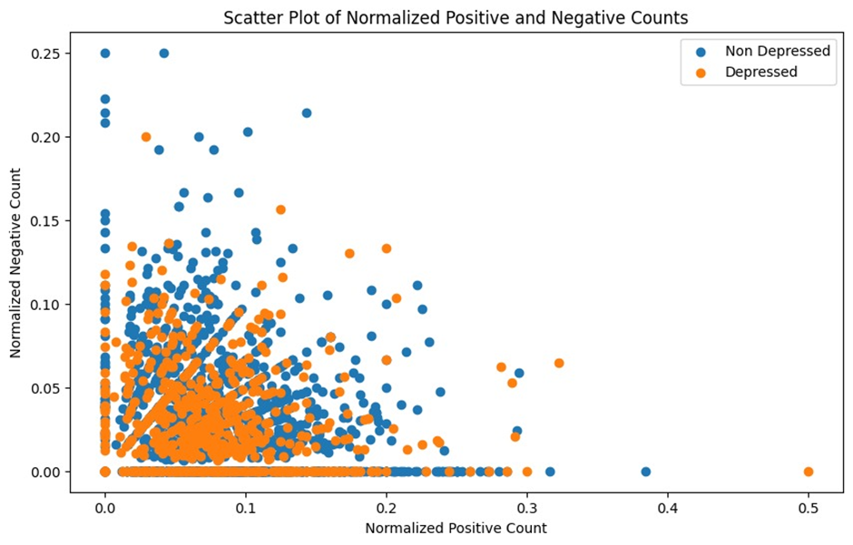
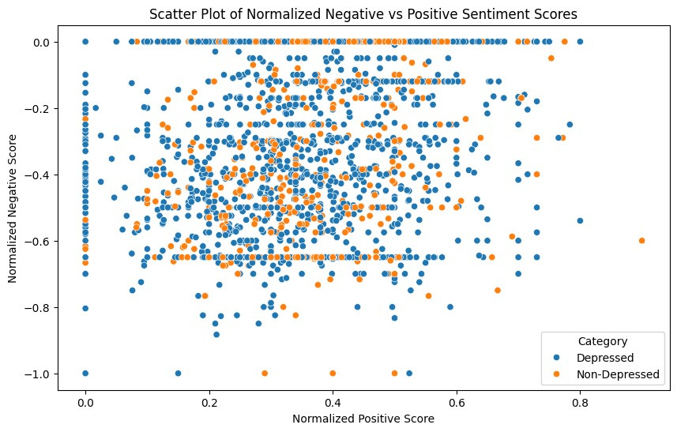
NORMALIZED POSITVE AND NEGATIVE COUNT AND SCORES
1st graph is normalized positive count
2nd graph is normalized positive score

Slide 18
AFINN
AFINN assigns a sentiment score to individual words, with scores ranging from -5 (most negative) to +5 (most positive).
The overall sentiment of a text is determined by summing the scores of all words in the text. A positive total score indicates positive sentiment, while a negative total score indicates negative sentiment.

Slide 19
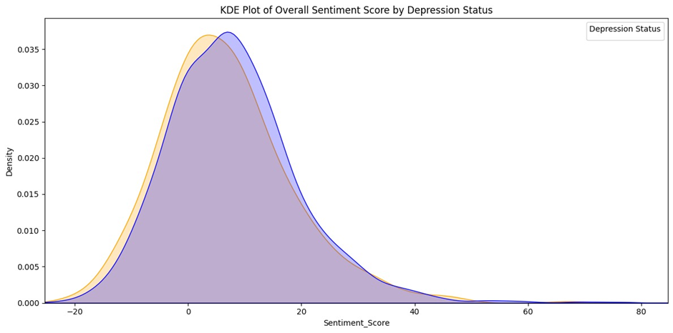
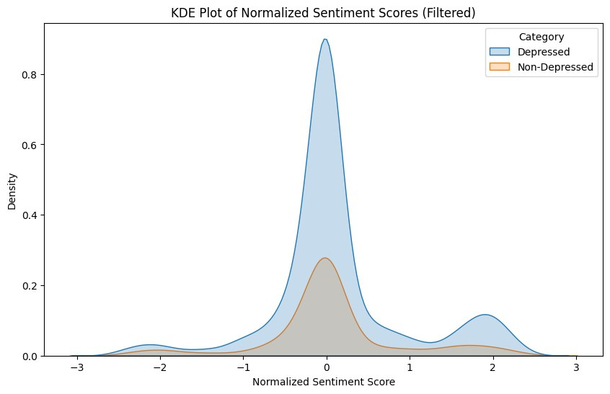
SENTIMENTAL SCORE
1st graph shows the Sentimental score for all text
2nd graph is normalized Sentimental score for depressed vs Non Depressed
we cannot find any relation between depressed vs non depressed from the above graphs

Slide 20
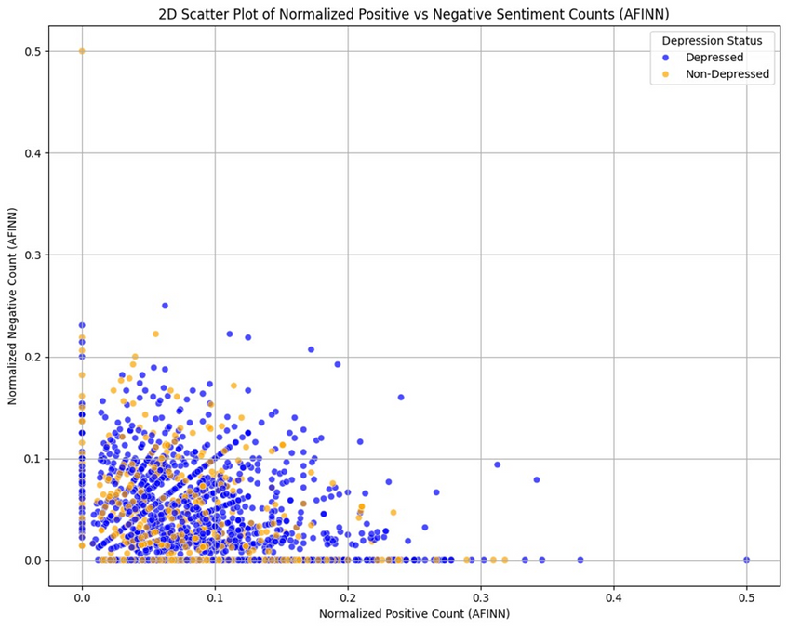
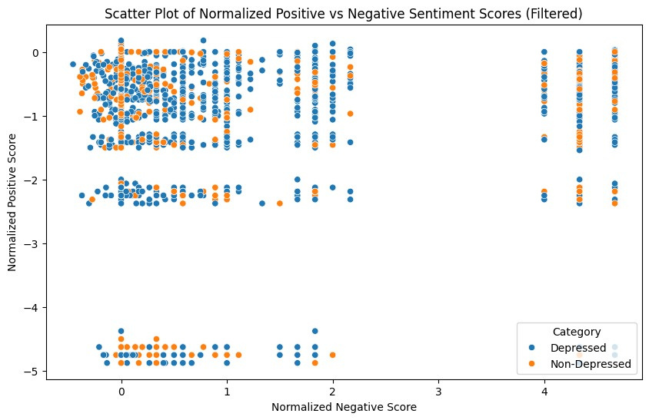
NORMALIZED POSITIVE VS NEGATIVE SCORE AND COUNT
1st graph is normalized positive vs negative count
2nd graph is normalized positive vs negative score

Slide 21
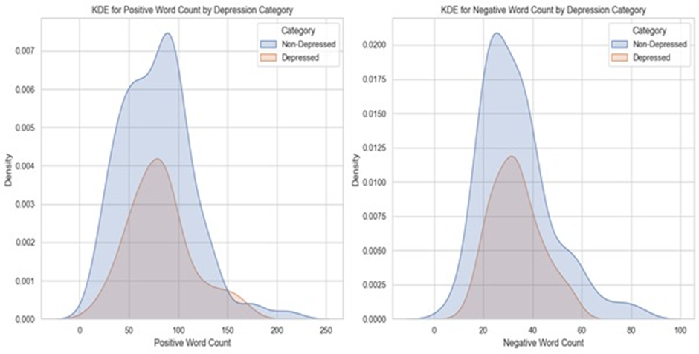
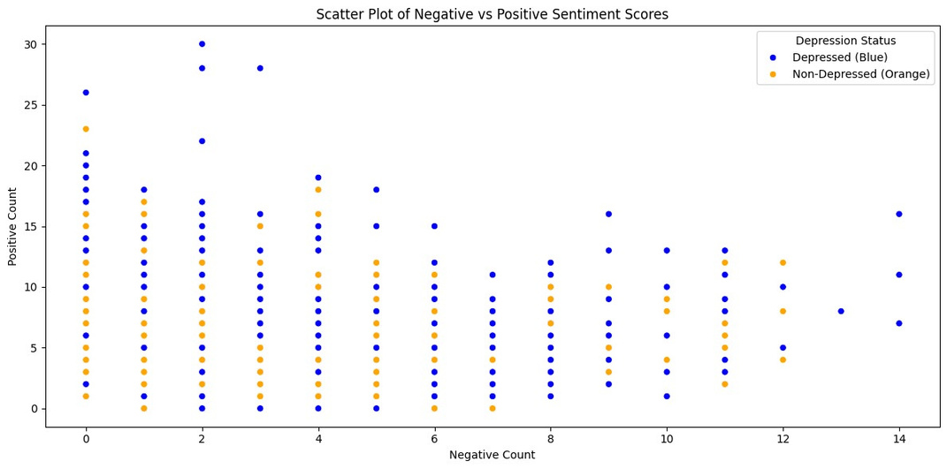
POSITIVEVS VS NEGATIVE COUNT
1st graph shows the Positive Word and Negative Word count for all text
2nd graph shows the Positive Word and Negative Word count for all text using Scatter plot
we cannot find any relation between depressed vs non depressed from the above graphs

Slide 22
SENTIWORDNET
SentiWordNet is a lexical resource that assigns sentiment scores to Text. These scores indicate the degree of positivity, negativity associated with the synsets.
Sentiment Scores: For each synset, SentiWordNet provides three scores:
Positive Score: The degree to which the synset expresses positive sentiment.
Negative Score: The degree to which the synset expresses negative sentiment.
Score is from 0 to 1.

Slide 23
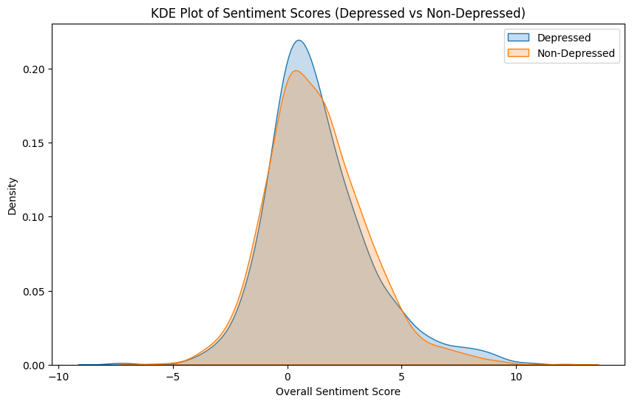
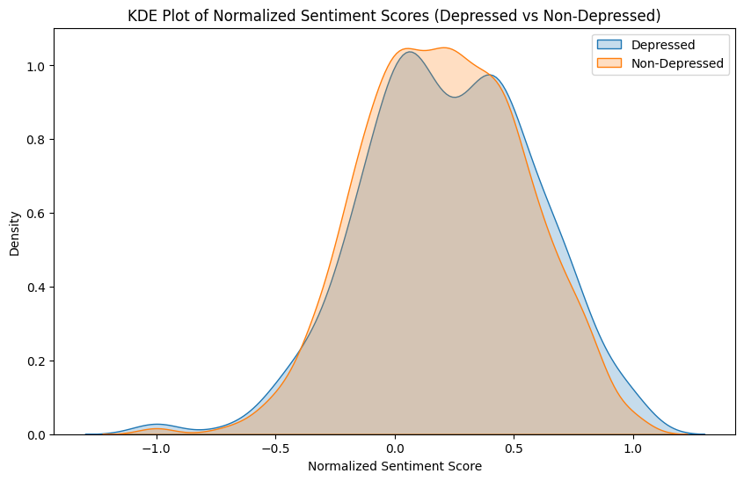
SENTIMENT SCORE

Slide 24
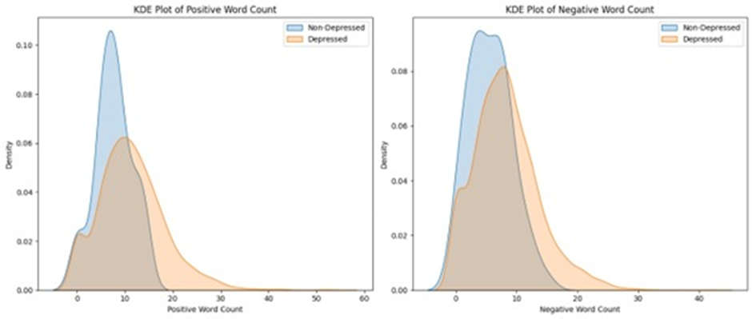
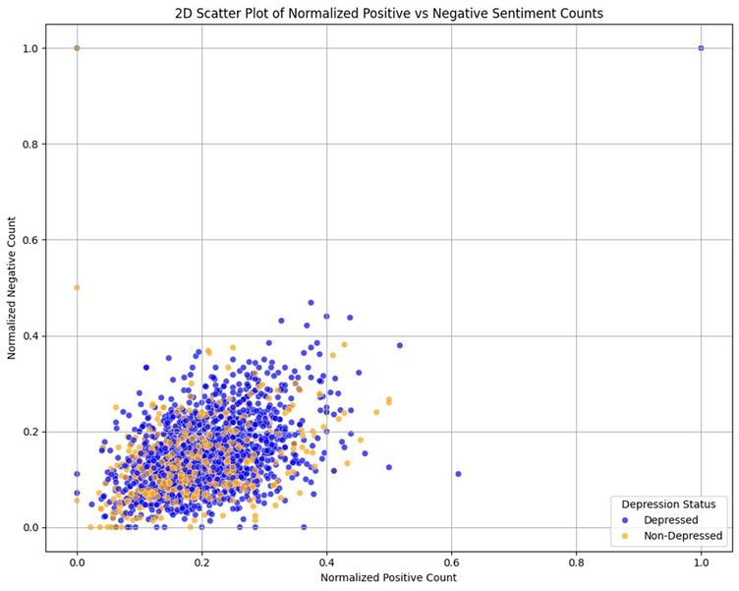
POSITIVE VS NEGATIVE WORD COUNT

Slide 25
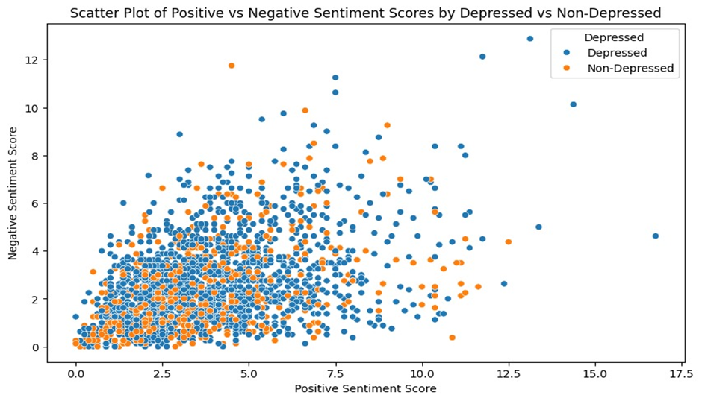
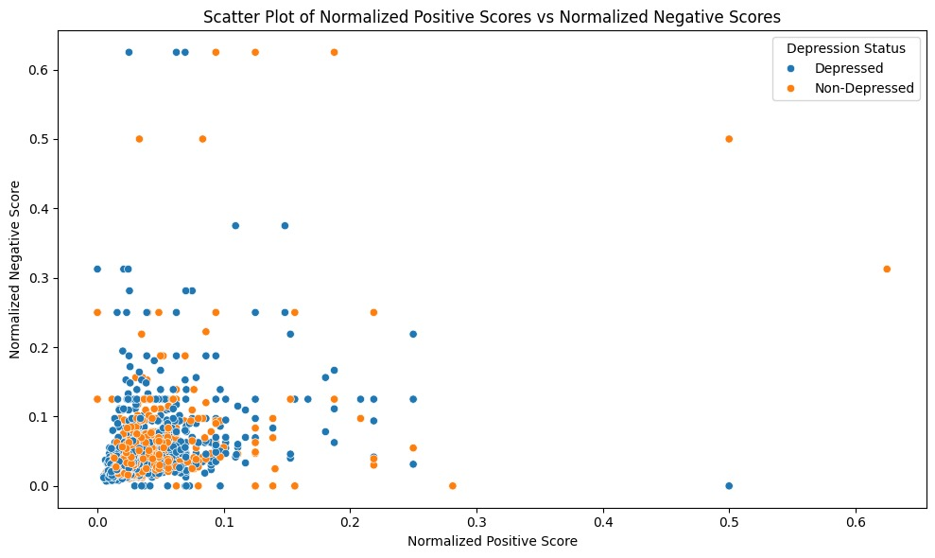
POSITIVE VS NEGATIVE SCORE

Slide 26
CONCLUSION
Overlap in Positive Language: Both depressed and non-depressed individuals use positive words, indicating that the presence of positive language alone is not a definitive indicator of emotional state.
Depressed individuals exhibit a heightened level of emotional expression, particularly in their use of emotionally charged words. This increased expressiveness may manifest as both positive and negative emotional content, highlighting the complexity of emotional communication in depression.
Our dataset, which includes a fixed set of 15 words for analysis, may not fully capture the nuanced emotional expressions of individuals. There is a possibility that depressed individuals might conceal their true emotions, leading to inaccuracies in identifying definitive positive and negative words.

Slide 27

Thank
You

